Slide 1

Campus Bluetooth Tag Network
CS-317
Faculty sponsored project with
Dr. Bulut, Department of Computer Science
Team Members:
Nicholas Bennett, Jordan Mays-Rowland, Justin Yirka
Notes:
Will we be able to present using google slides directly?
I hope so. (I’ll just send him a view only copy, plus a pdf)
-- Need to make sure pdf preserves animations where necessary.
-- Need to be able to load presentation immediately at podium

Slide 2

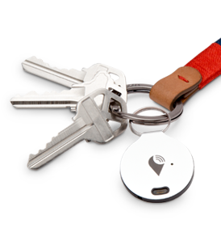
The problem
Notes:
As we explained in our proposals,
Lost item tracking is very important.
(* One of us should hold up an example. Attach an estimote to one of our wallets or something and hold it up *)
There are some products out there right now.
But, what about at VCU? - It would be great if VCUPD could have an inexpensive option to hand these out, just like they do bike locks.
This is our project

Slide 3
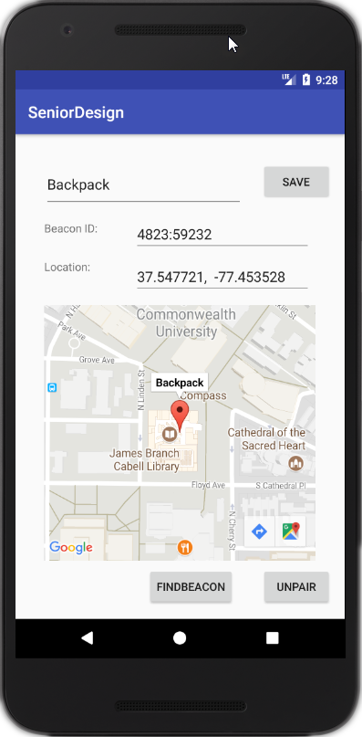
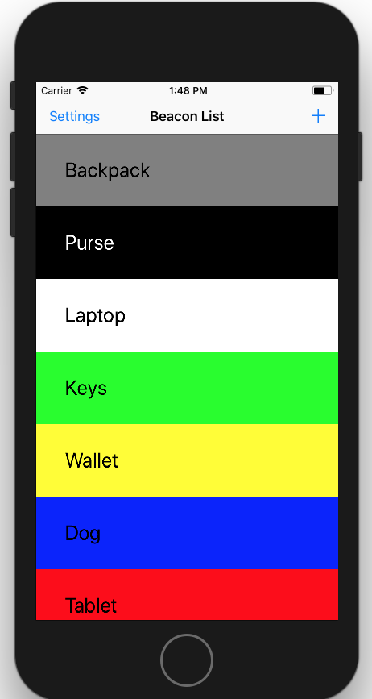
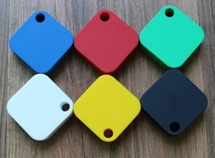


The problem
Notes:
FIRST:
We have a prototype. For BOTH systems, developing in parallel!

Slide 4
The solution
Crowd GPS | Customize To Campus | VCU-PD | Branding
 | Security & Privacy
Notes:
Now, let’s talk about what’s innovative about our solution. We are NOT just copying tile for VCU.
Crowd GPS = strength in numbers.
It will be particularly effective if we can saturate a given community.

Slide 5
The solution
Crowd GPS | Customize To Campus | VCU-PD | Branding
 | Security & Privacy
Notes:
Off-the-shelf vs custom.
Since we know who our client is, we can do better.

Slide 6

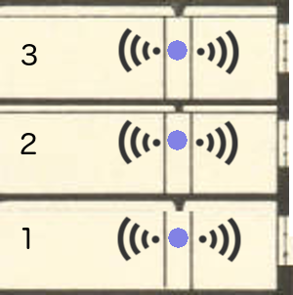



Fixed Receivers
Notes:
Innovative:
Existing products depend on GPS.
GPS works poorly indoors laterally, due to signal strength.
GPS has never been able to tell you the floor.
Sure, it may tell you your item is in some building, but that’s not helpful in a large building with many floors
So: Fixed, location-aware receivers throughout campus. Passively (and anonymously!! - we’ll get to this later) report with precision such as floor or wing or room.

Slide 7
The solution
Crowd GPS | Customize To Campus | VCU-PD | Branding
 | Security & Privacy

Slide 8
The solution
Crowd GPS | Customize To Campus | VCU-PD | Branding
 | Security & Privacy
Notes:
Privacy is a big concern. Security is never guaranteed.
Luckily, Dr. Bulut is a mobile security researcher. He introduced us to this paper on the security of crowdGPS.
Summary: Tile and TrackR are unsecure.
Users can be followed by tracking their tags.
Tag GPS data is stored such that it’s exposed to hackers if they break in and to Government warrants.

Slide 9
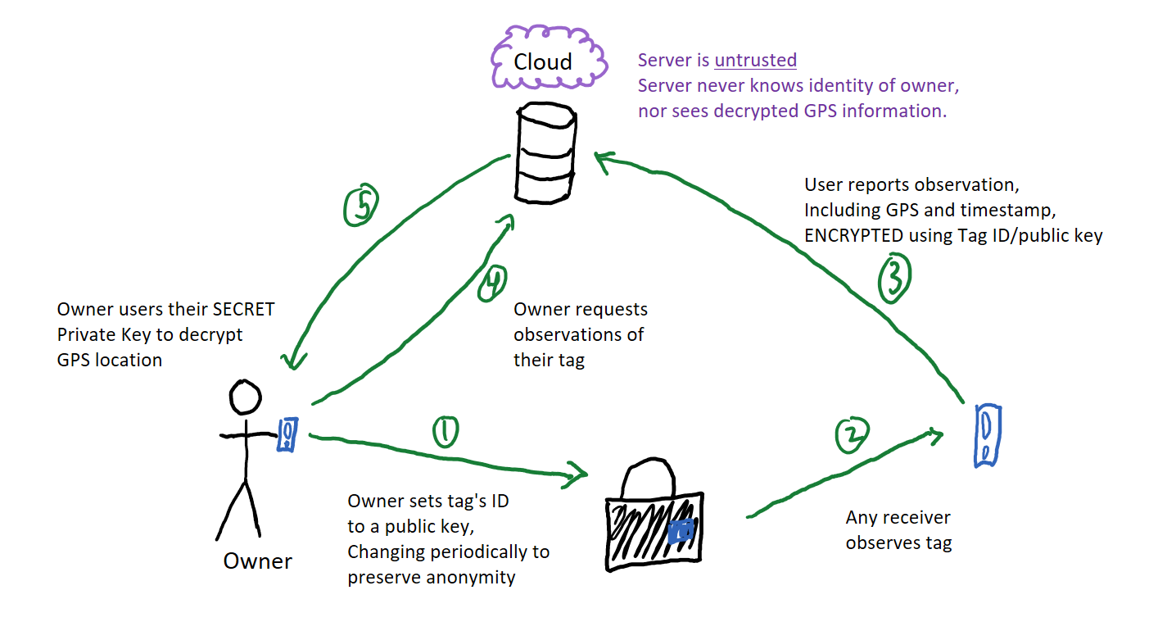
Notes:
We follow the model of untrusted server, and of preserving anonymity.
Server never has access to GPS information. Even if server is hacked, even if served with warrant, your info and your habits are secured.
We will also periodically change your tag’s information. That way, nobody else can track you with their own network of scanners.
This picture looks silly!! But it should be simple. We want our users to understand and be able to verify their privacy.
We want to demonstrate that the campus respects privacy and takes security seriously (you can imagine some students having concerns)
Plus, this will Contribute to research paper with Dr. Bulut.

Slide 10
The solution
Crowd GPS | Customize To Campus | VCU-PD | Branding
 | Security & Privacy

Slide 11
The solution
Crowd GPS | Customize To Campus | VCU-PD | Branding
 | Security & Privacy
Notes:
VCU-PD has goals: Prevent loss and prevent theft. - helping them do this is how our project benefits the community.
Our project was inspired by conversations between our adviser and VCU-PD.
So: We will develop features we’ve already identified as useful, and we plan to continue these conversation later in the semester.

Slide 12
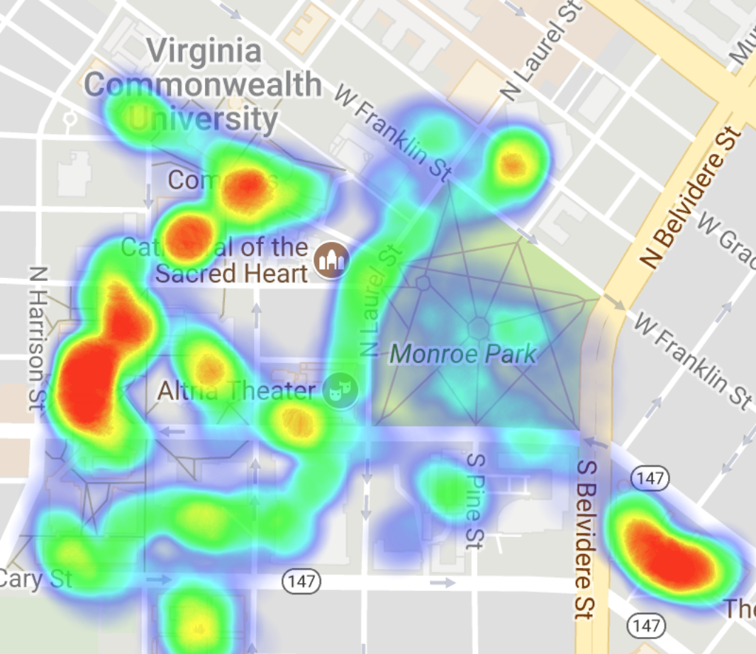
Beacon Coverage
Notes:
Officers routinely patrol campus. And incredibly common reports are of lost items and stolen items.
This will give a special screen available on the phones of officers to see a heatmap of traffic around campus.
Officers can direct their patrols to less trafficked areas, because these are areas where undiscovered lost items may be found.
If lost items are observed, owners are notified via the app.

Slide 13
The solution
Crowd GPS | Customize To Campus | VCU-PD | Branding
 | Security & Privacy

Slide 14

The solution
Crowd GPS | Customize To Campus | VCU-PD | Branding
 | Security & Privacy
Notes:
Finally: Everyone wants more VCU gear.

Slide 15
Milestones
February 2018
May 2018
November 2017
December 2017
March 2018
Meet with VCU-PD
Privately test
Refine look & feel
Capstone Expo
Hand off to school & VCU-PD
Current prototype: Non-novel features
Nov | Dec | Jan | Feb | Mar | Apr | May | ...
Prototype: All core features
Beta Test (next slide)

Slide 16
Milestones
February 2018
May 2018
November 2017
December 2017
March 2018
Meet with VCU-PD
Privately test
Refine look & feel
Capstone Expo
Hand off to school & VCU-PD
Current prototype: Non-novel features
Nov | Dec | Jan | Feb | Mar | Apr | May | ...
Prototype: All core features
Beta Test (next slide)

Slide 17
Milestones
February 2018
May 2018
November 2017
December 2017
March 2018
Meet with VCU-PD
Privately test
Refine look & feel
Capstone Expo
Hand off to school & VCU-PD
Current prototype: Non-novel features
Nov | Dec | Jan | Feb | Mar | Apr | May | ...
Prototype: All core features
Beta Test (next slide)

Slide 18
Milestones
February 2018
May 2018
November 2017
December 2017
March 2018
Meet with VCU-PD
Privately test
Refine look & feel
Capstone Expo
Hand off to school & VCU-PD
Current prototype: Non-novel features
Nov | Dec | Jan | Feb | Mar | Apr | May | ...
Prototype: All core features
Beta Test (next slide)

Slide 19
Milestones
February 2018
May 2018
November 2017
December 2017
March 2018
Meet with VCU-PD
Privately test
Refine look & feel
Capstone Expo
Hand off to school & VCU-PD
Current prototype: Non-novel features
Nov | Dec | Jan | Feb | Mar | Apr | May | ...
Prototype: All core features
Beta Test (next slide)
Notes:
Goals after hand off: VCU implements
Open source could be implemented elsewhere.
Suggests opportunity for monetization thru consulting (think Red hat)

Slide 20
Funding request
3 Raspberry Pi’s
500 user beta test
3 Raspberry Pi’s
100 user beta test
3 Raspberry Pi’s 18 more beacons → 24 user beta test
Notes:
Note: We have now ordered the beacons from China.
*
“We have two goals for pursuing this award:
Recognition. As far as we’re aware, the CS dept has not won one of these. We believe we are innovating, and that CS is uniquely capable of success because of rapid prototyping
Extending our project - for this, we require funds. -- describe beta test”
*

Slide 21
Funding request
$0
3 Raspberry Pi’s
500 user beta test
3 Raspberry Pi’s
100 user beta test
3 Raspberry Pi’s 18 more beacons → 24 user beta test
Notes:
So, even $0 accomplishes first goal

Slide 22
Funding request
$660
$0
3 Raspberry Pi’s
500 user beta test
3 Raspberry Pi’s
100 user beta test
3 Raspberry Pi’s 18 more beacons → 24 user beta test

Slide 23
Funding request
$3975
$660
$0
3 Raspberry Pi’s
500 user beta test
3 Raspberry Pi’s
100 user beta test
3 Raspberry Pi’s 18 more beacons → 24 user beta test
Notes:
More options detailed in packet.

Slide 24
Summary
Innovation Stationary, location-aware scanners Positive Impact Support for VCU-PD Loss & theft prevention Research Security and Privacy safeguards | Demonstrated success Rapid prototyping Samples already purchased Goal Beta test in March 2018 Budget: $0 to $7650 Size: 24 to 1000 users
Campus Bluetooth Tag Network
CS-317
Notes:
Do not leave this slide at end. Leave it up while they ask questions.
(summary is better than blank!!!)
In fact, we can just leave this slide up, no talking. Don’t let the time count against us - they’ll see it.

